Slide 1
6.Learning Phrase Representations using RNN Encoder–Decoder for Statistical Machine Translation
Group P
Ding Yu (dy212190@connect.hku.hk)
Sun Jianan (sun1999@connect.hku.hk)
Yan Lijun (yanlijun@connect.hku.hk)
Yue Tian (yuetian@connect.hku.hk)

Slide 2
1.RNN Encoder-Decoder and Statistical Machine Translation
4 Types of RNN:
1 vs N:
N vs 1:
N vs N:
Source: https://www.coursera.org

Slide 3
1.RNN Encoder-Decoder and Statistical Machine Translation
N vs M:
The two sentences have different length of sequence but with same meaning.
Source: https://www.coursera.org

Slide 4
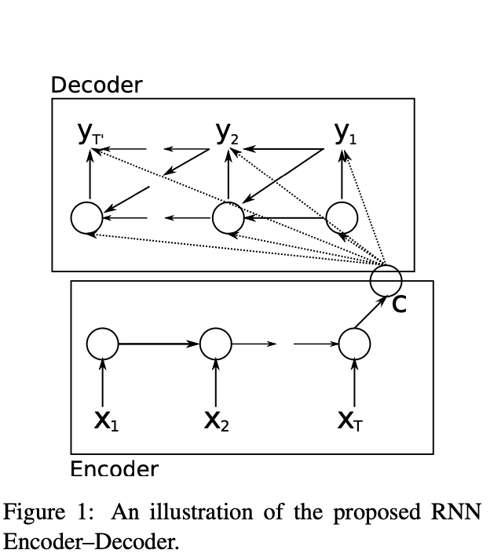
1.RNN Encoder-Decoder and Statistical Machine Translation
Encoder and Decoder
Model consists of two RNNs and hidden units
Encoder
Learns to encode a variable-length input sequence
into a fixed-length vector representation.
Decoder
Learns to decode a given fixed-length vector
representation into a variable-length target sequence.
Hidden Unit

Slide 5

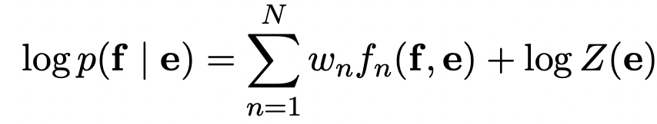
1.RNN Encoder-Decoder and Statistical Machine Translation
Statistical Machine Translation
In the phrase-based SMT framework, the translation model is factorised into the translation probabilities of matching phrases in the source and target sentences.
RNN Encoder-Decoder can be used to rescore the phrase pairs in the phrase table.
To maximize:
For Bilingual Evaluation Understudy score:

Slide 6
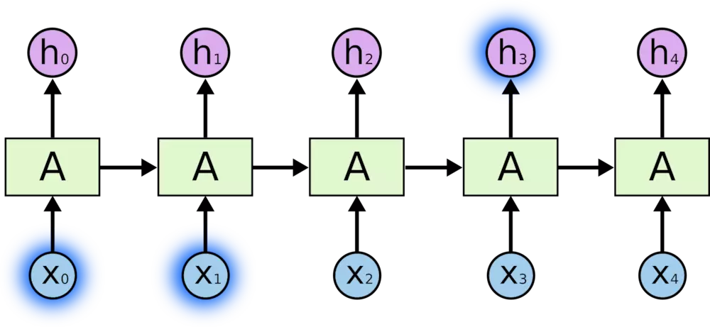
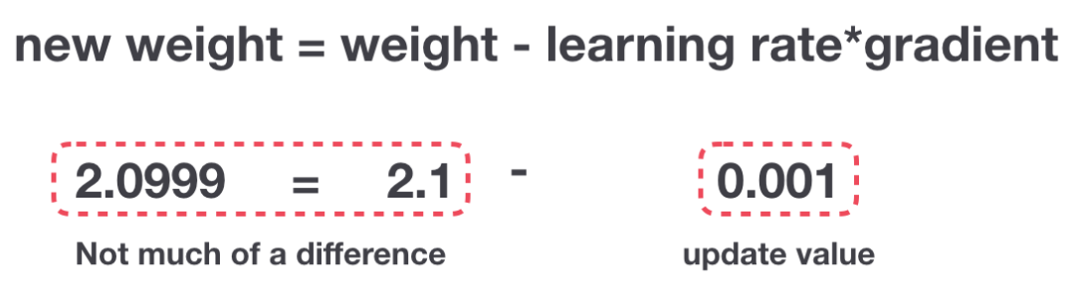
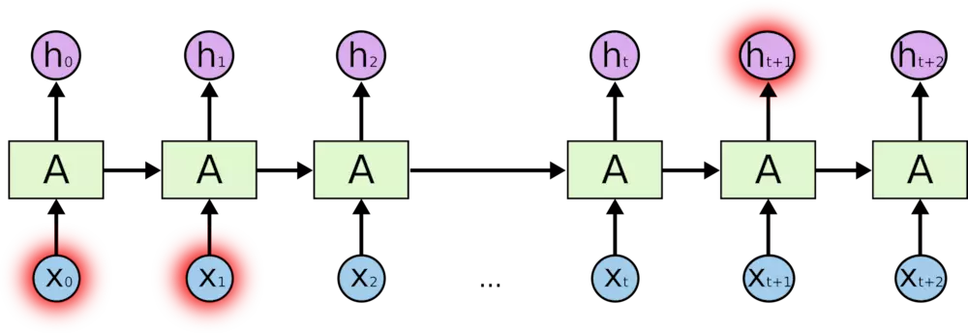
2. Short Memory Problem
It has been observed by Bengio et al [1994] that it is difficult to train RNNs to caputure long-term dependencies because of vanishing gradient.
For example, we get a sequence :
I grew up in China… I speak fluent Chinese.
Source: https://towardsdatascience.com

Slide 7
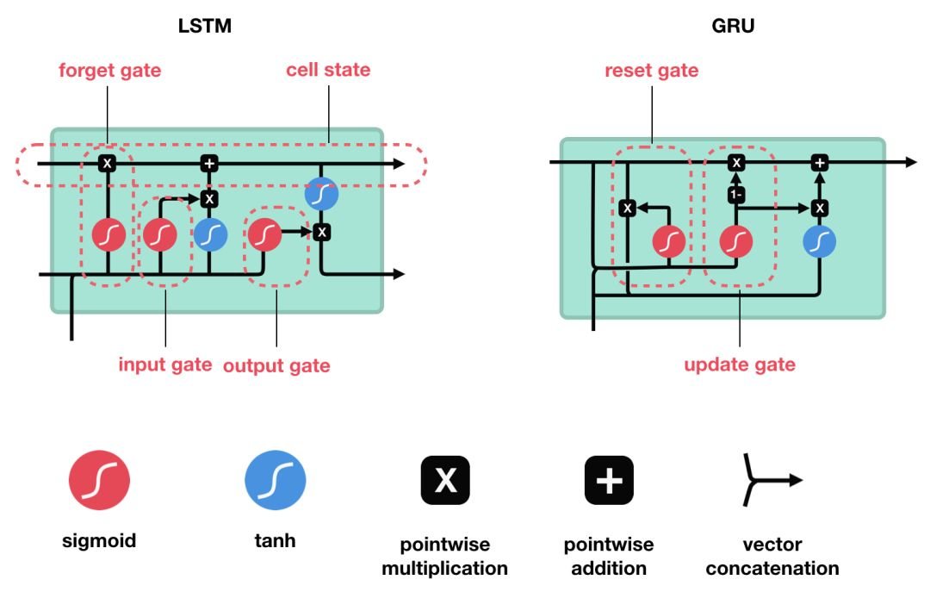
2. GRUs
pretty similar to an LSTM
GRU gets rid of the cell state and used the hidden state to transfer information (memory).
Source: https://towardsdatascience.com

Slide 8
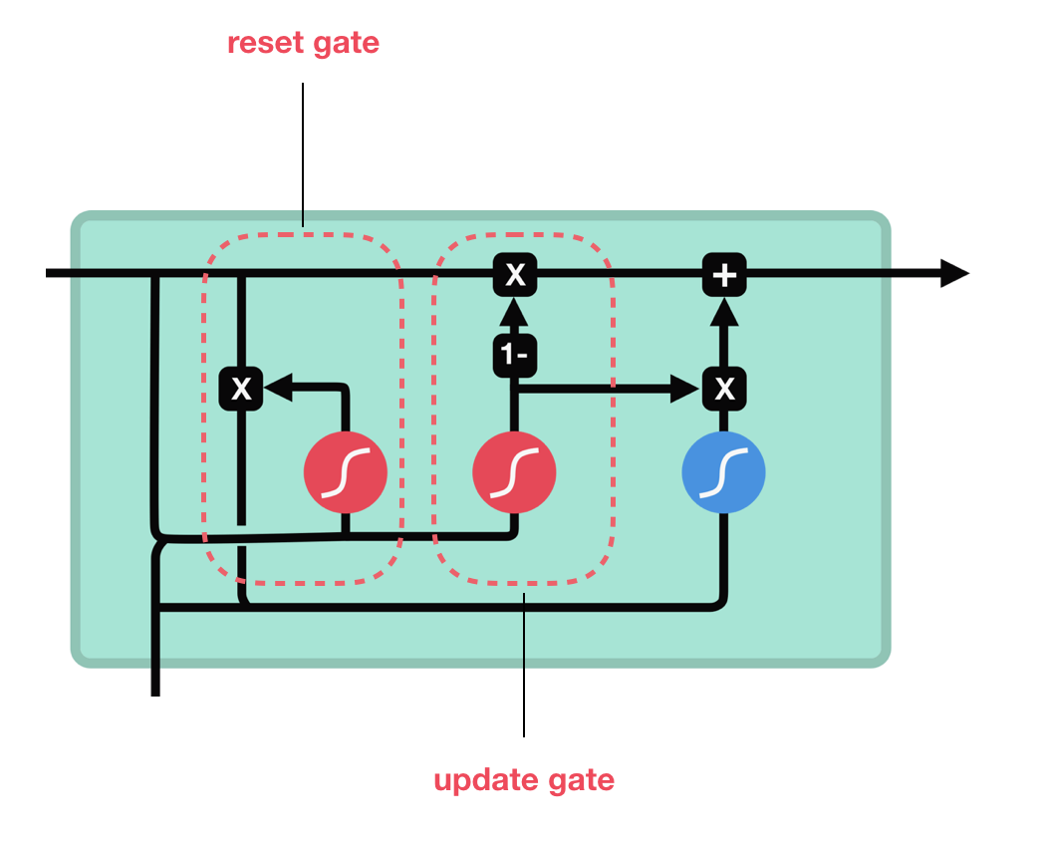
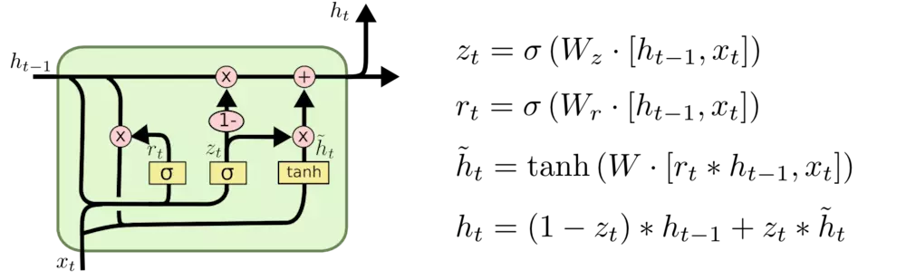
2. GRUs
pretty similar to an LSTM
GRU gets rid of the cell state and used the hidden state to transfer information (memory).
Two gates: reset gate and update gate
Source: https://towardsdatascience.com

Slide 9

2. LSTM vs GRU
 | LSTM | GRU
Difference 1 | Control exposure of memory content | Exposes its full content without any control
Difference 2 (when computing the new memory) | Separate forget gate and input gate: No control of the amount | Just one reset gate: controls the information flow from the previous activation
Source: https://towardsdatascience.com

Slide 10
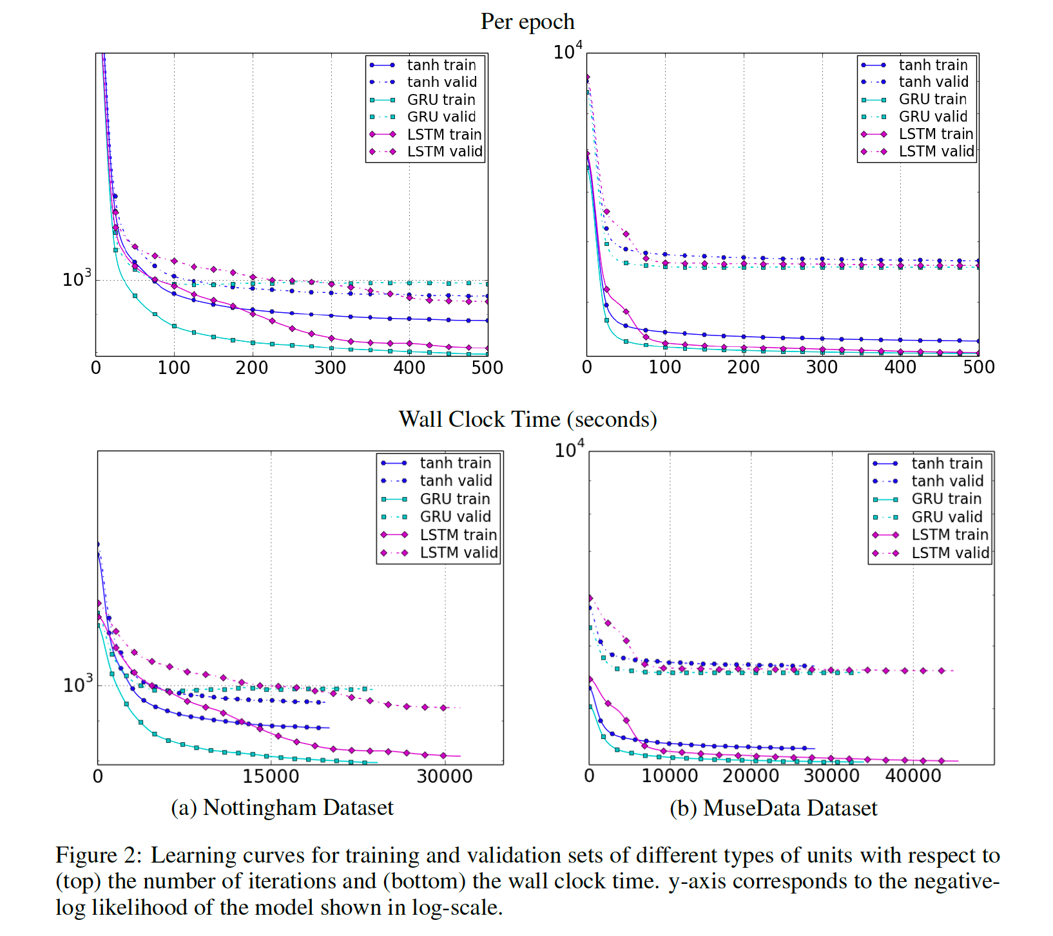
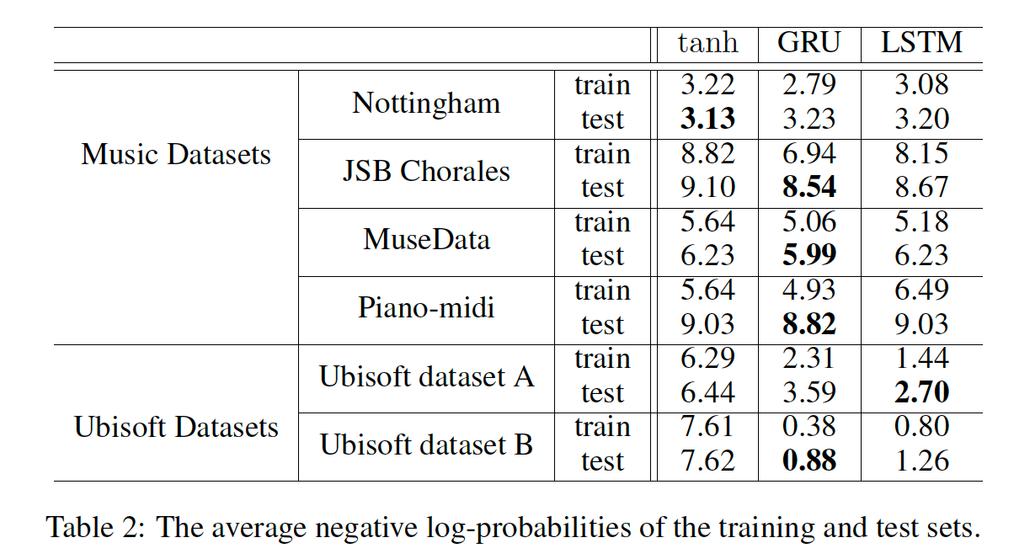
2. LSTM vs GRU
Source: Empirical Evaluation of Gated Recurrent Neural Networks on Sequence Modeling 2014.

Slide 11
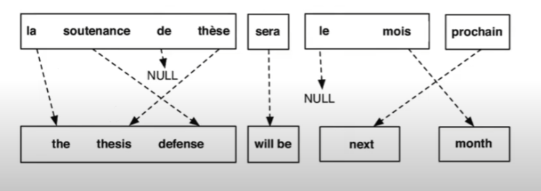
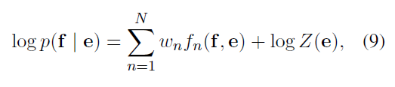
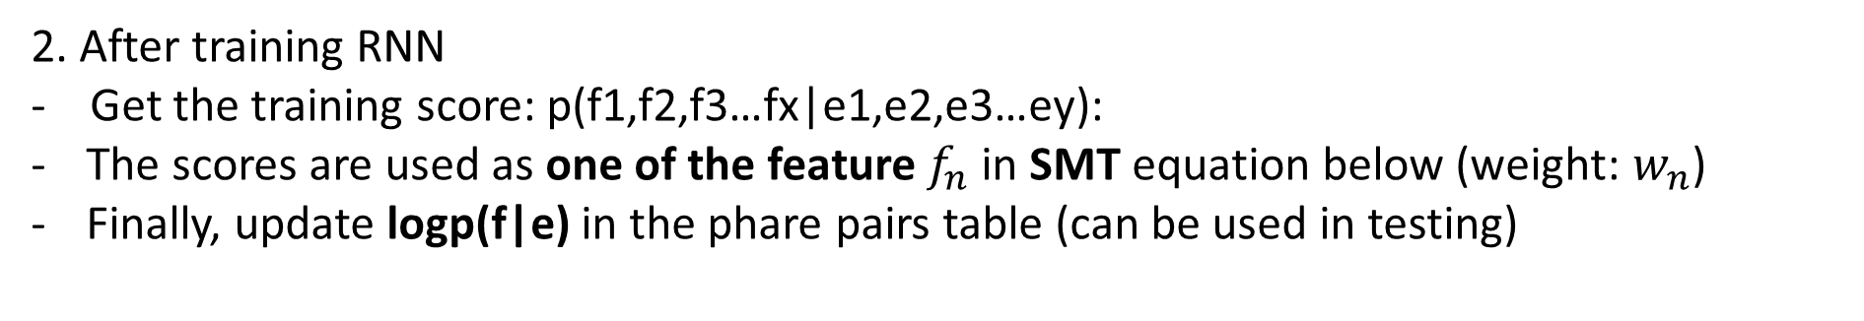
3.Experiment: English to French (WMT’14 Workshop Task)
Data: English-French Bitext: (Training + Development + Validation + Test)
Preprocessing: Word Segmentation (Tokenization)
Input phrases are embedded in dimension of 100
Rescoring Phrase Pairs:
1. Train the RNN encoder-decoder (with GRU hidden units) on a table of phrase pairs
2. After training RNN
- Get the training score: p(f1,f2,f3…fx|e1,e2,e3…ey):
The scores are used as one of the feature $f_{n}$ in SMT equation below (weight: $w_{n}$)
Finally, update logp(f|e) in the phare pairs table (can be used in testing)

Slide 12
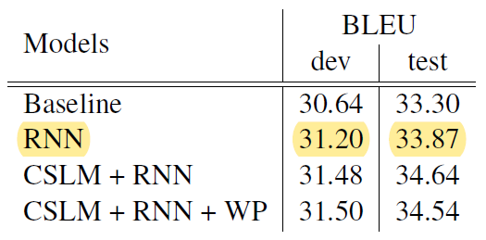
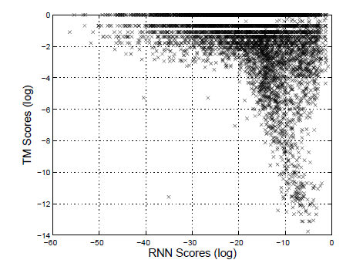
3.Experiment
Quantitative Result: BLEU (Bilingual Evaluation Understudy) score
Qualitative Result:
RNN is better than translation model (TM) that directly applies conditional probability. (see table 2,3)
Baseline Model can be found on: http://www.statmt.org/moses/

Slide 13
3.Experiment
Phrase Representation

Slide 14
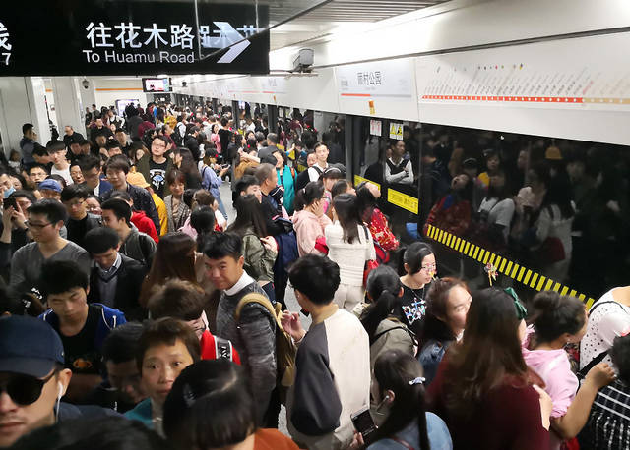
4.Experiment: GRU on Time-Series Problem
Predictions of passenger flow in Shanghai subway

Slide 15


4.Experiment: GRU on Time-Series Problem
Predictions of passenger flow in Shanghai subway
Dataset:
Passenger card-swiping data of Shanghai Subway in April 2015
from a public contest, download link(m4og)
Preprocessing:
Passenger flow count by time step (every 15 minutes)
Min-max normalization
Source: https://image.baidu.com/
Modeling:
Use three-period lagged data(last three time steps) to predict passenger flow in next time step
predict
${（X}_{t−1}，X_{t−2}$， $X_{t−3}$）
$$X_{t}$$

Slide 16
4.Experiment: GRU on Time-Series Problem
Predictions of passenger flow in Shanghai subway
Demo

Slide 17
Q&A

